Slide 1



Slide 2
userfriendlyfood.com
BAKERY

Slide 3
INTRODUCTION
In web development, there are three possible career options that you can choose:
Front-end development
Back-end development
Full stack development
Intro of HTML
HTML stands for Hyper Text Markup Language for creating web pages and web application.
Web browser receive HTML document for a web server of from local storage and render the document into multimedia web pages.
Intro of CSS
CSS stands for cascading style sheet use for describing the presentation of a document return in a markup language like html.
CSS is designed to enable the separation of presentation and content , including color , border and layout.
Intro of Java-Script
A high level interrupted programming language , it is dynamic language.
JS enables interactive web pages and is an essential part of web application .
The best majority of web site use it, and major web browsers have a dedicated JS engine to execute it.

Slide 4
WEB – DEVELOPMENT
Web Development can simply be defined as the building end maintained of website for hosting via the internet
Or the internet(private network)
It’s all about creating web pages(web site) or applications(such as amazon or Facebook) that is run in a web
Browser.
Web development often involves learning several programming languages , frameworks , databases ,etc.
As different website and apps used different technologies and have different functionality .

Slide 5
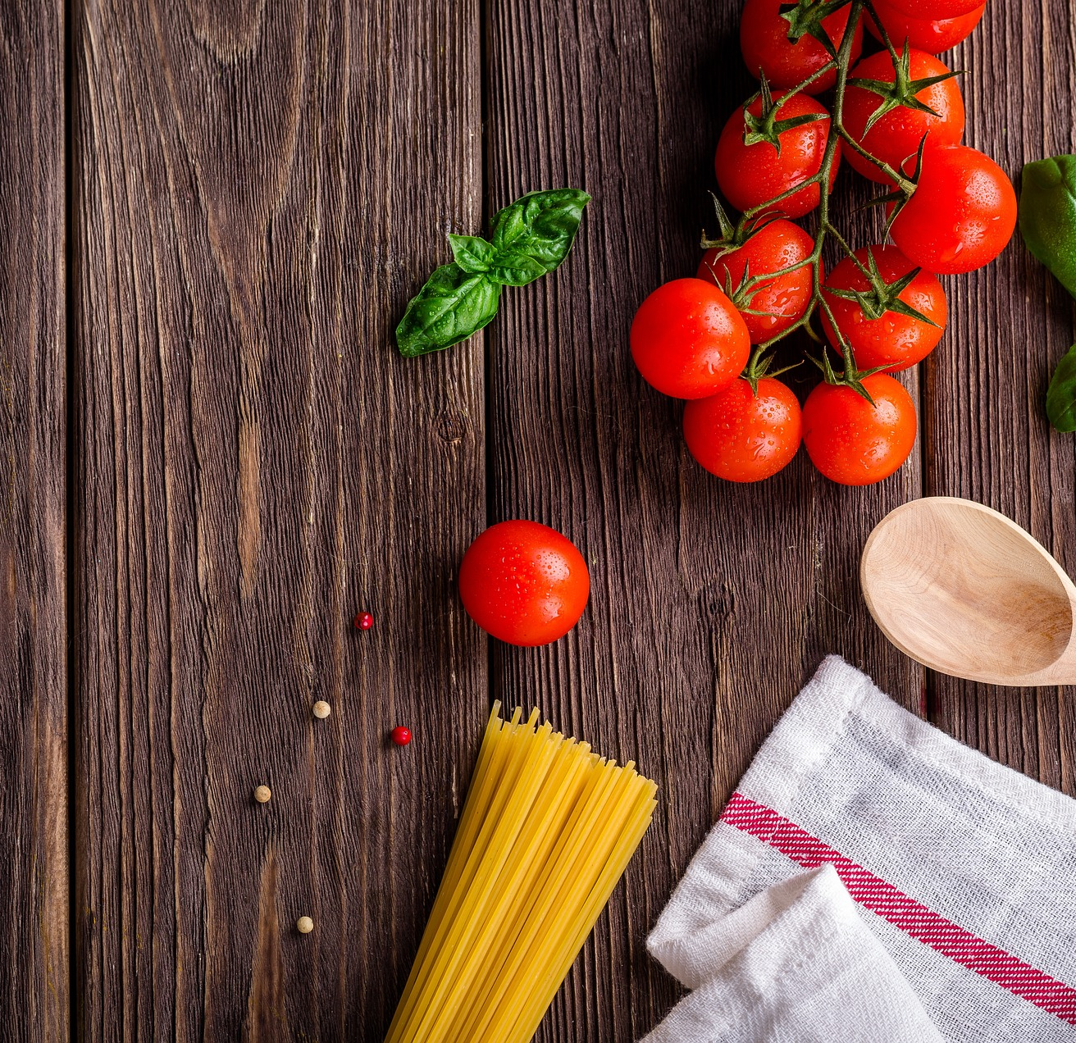
Team Members : Rajkumar Jangid Rahul Sharma

Slide 6
Features
01
Portable
Website is portable for any OS(Windows , Linux , UNIX , Android )
02
Easy to Access
Any user who have not knowledge more about computer , he also access website easily .
03
Low level architecture
In background not difficult architecture has included so low level programmer can easily understand better.
04
Interactive Interface
In this website , interface quality so high user can used all type of services in front page .

Slide 7
Language Included
10%
40%
A (JS)
B (CSS)
C (HTML)
JavaScript.
Cascading style sheet .
50%
Hyper Text Markup Language.

Slide 8
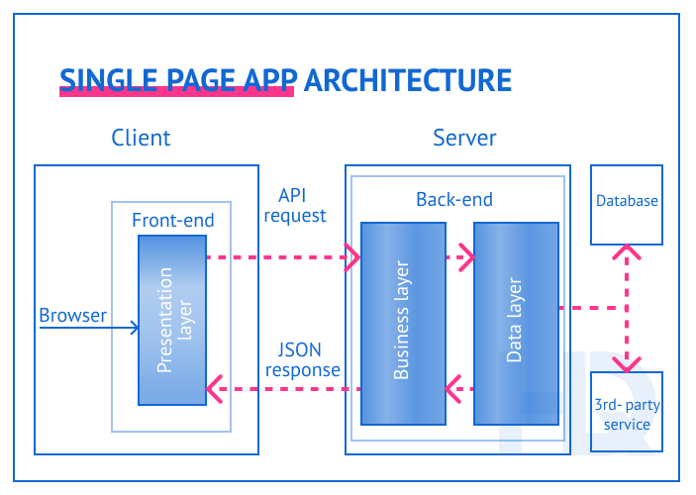
CLIENT-SERVER WEB ARCHITECTURE

Slide 9
You can simply ordered your likening food through our website , it provide best user friendly interface for any user who have not core knowledge about internet suffering and also have not knowledge about computer . In this website ,we included so many items accordingly user need . Website basically designed for National and international domain . Our major Client for international domain for Apple , Microsoft , HP , Instagram and Google.

Slide 10
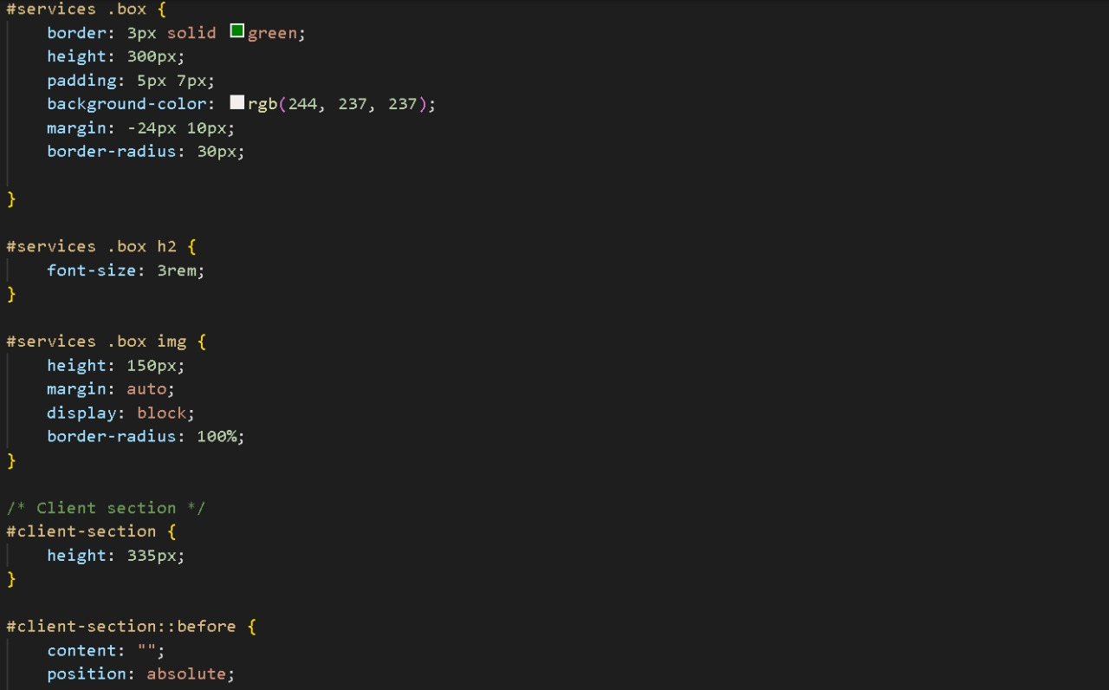
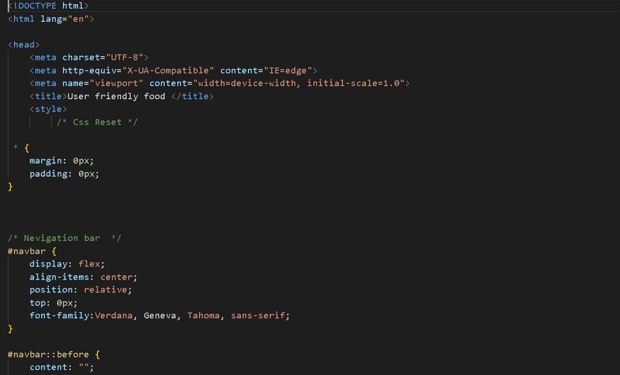
CSS and HTML Front Pages of Code

Slide 11
Contact By Users
Userfriendlyfood.com
The above Email Address for ordering food through online mode, user can choose their item from our website then he can provide item list through given Email Address easily.
Through FAX
123******234
User also ordered their food list through Mobile Number. If he/she is unable to send list through online food (by website).
Through Mobile

Slide 12
Categorizes of Meals
Veg
Sweets
50%
15%
For Vegetarian Customers , we have 50% items. user simply select veg categorizes to choose veg items .
User can choose their favorite Sweet item. We have 25% Sweet categorizes.
Non - Veg
Fast-food
20%
15%
For Non-Vegetarian Customers , we have 20% items. user simply select Non-veg categorizes to choose items.
According to our customers need, we have Fast-food categorizes 25%.

Slide 13
Indian Pizza( Famous domain for Facebook Clients ).
$34
Dal Bate Churma( Famous domain for Microsoft Clients).
$12
Fry Fish(Famous Domain for Apple Clients).
$23
Best Items List with Clients List

Slide 14
THANK YOU

